Slide 1




The Richfield Book Club is an exclusive inline platform designed to foster a vibrant community of literature enthusiasts among the Richfield students

Slide 2
The Richfield Book Club is an exclusive inline platform designed to foster a vibrant community of literature enthusiasts among the Richfield students

Slide 3

Purpose

Slide 4


Purpose
The purpose of creating this project is for a book club on your campus (Richfield Umhlanga Campus) is to provide a centralized online platform where members of the book club can access information, engage in discussions in our in-built community chat, and stay updated on club activities.

Slide 5

Objectives

Slide 6


Objectives
Information Sharing
Event Management
Book Management
Member Profiles/usernames
Accessibility
Social Media Integration

Slide 7

Web Site Design

Slide 8

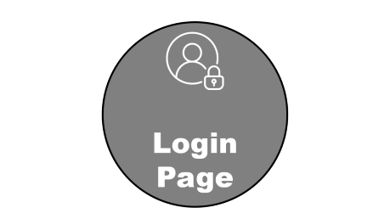
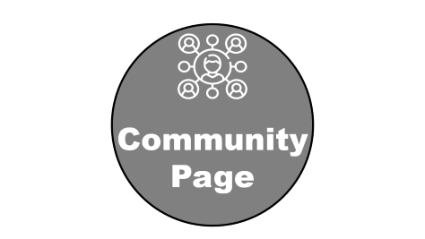
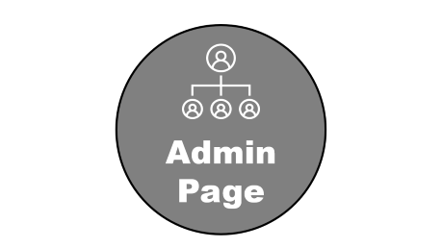

Web Site Design

Slide 9

Login Page

Slide 10
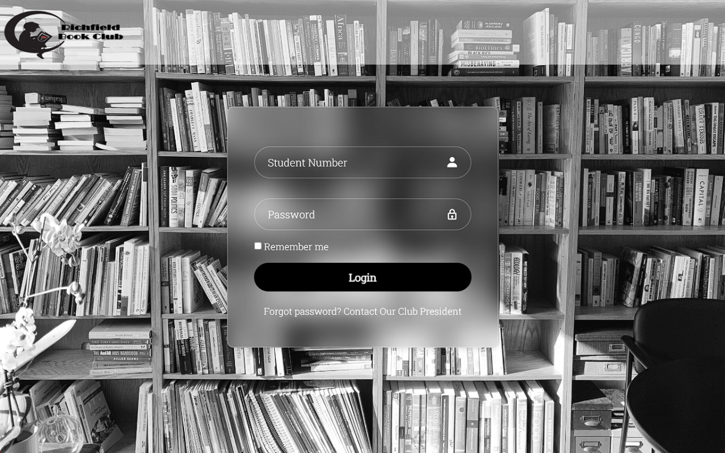
Serving as a gateway for registered students, the main logo page streamlines access to the Richfield Online Book Club.
To ensure secure and organized environment, the club president must first add students through the administrator page, granting them authorized access.
Login Page

Slide 11

Update Page

Slide 12
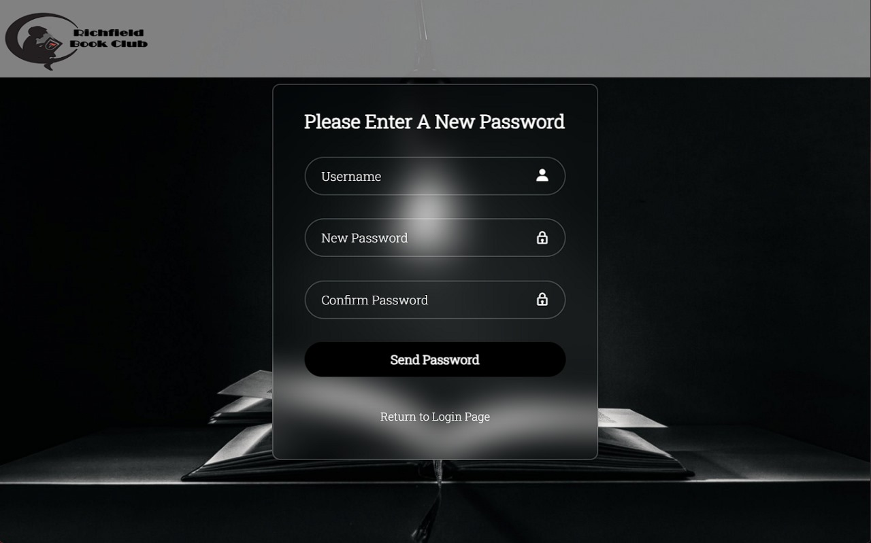
This page only be available to student numbers that have been recognized by the database.
They will be asked to change their password and create a username
Update Page

Slide 13
Admin Page

Slide 14
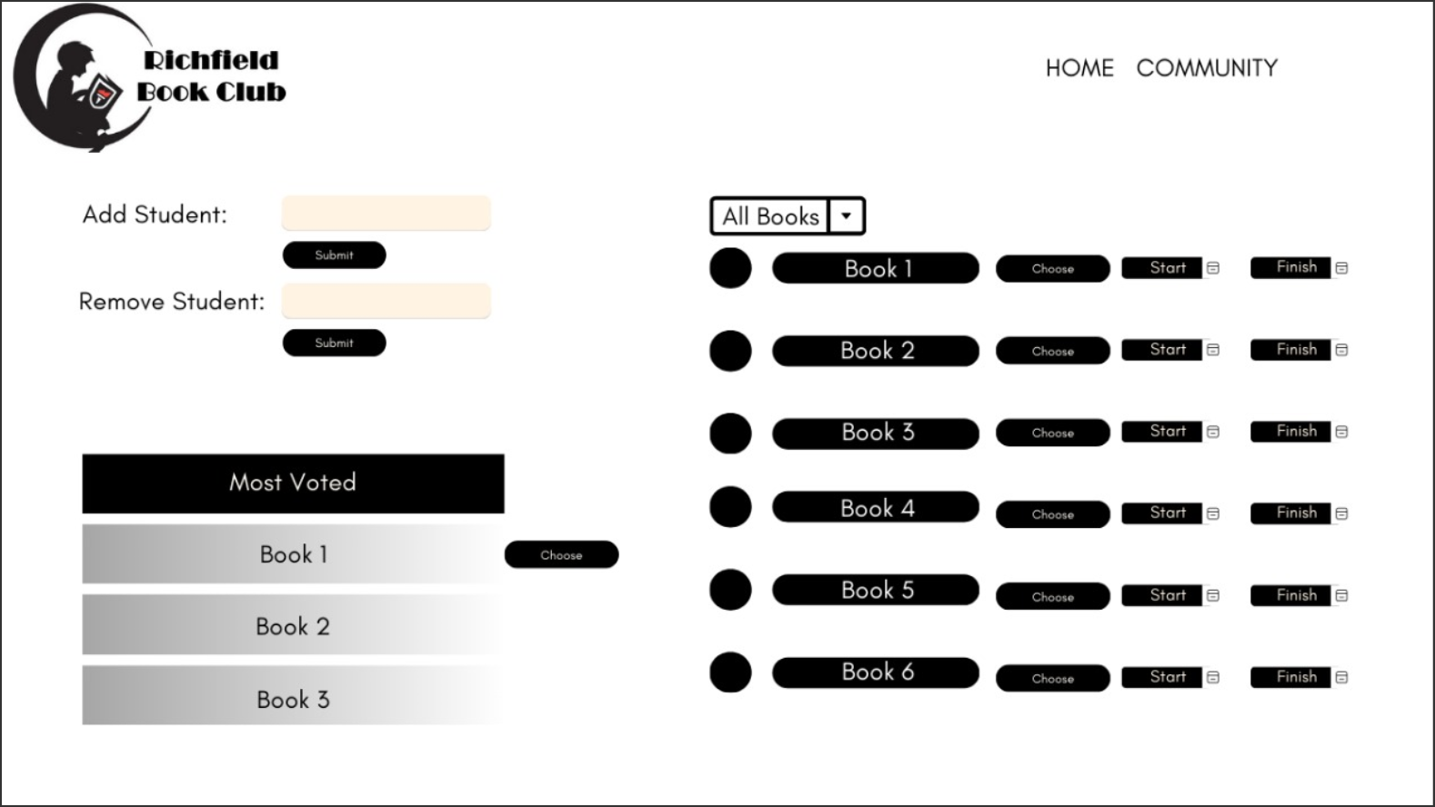
Admin Page

Slide 15

Community Page

Slide 16
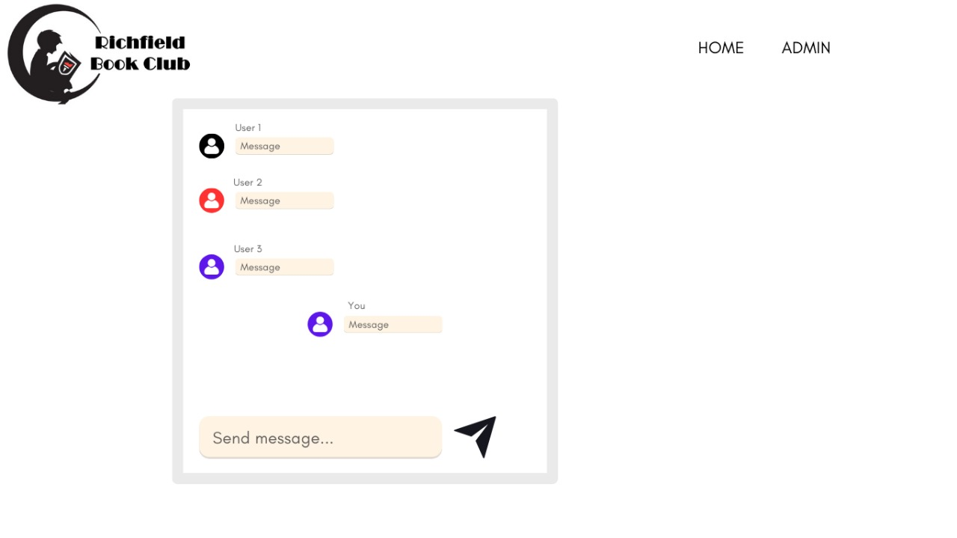

The Richfield Online Book Club’s interactive platform fosters engaging discussions among students
Community Page

Slide 17
Thank You

